Slide 1
CBIT DISCUSSION FORUM speak up CBIT!!
V.Hyndavi -160116737066
N.Sai Nikhita-160116737076

Slide 2
Problem Statement
Students in cbit don’t have an official platform to report their issues.
So we introduced a platform where all the issues regarding college can be discussed in an uncontroversial way anonymously.

Slide 3
Existing System
There is no official forum but there is a student created confessions page in facebook
Unrelated topics are discussed mostly and no use is gained from it to the students or to the management.

Slide 4
Proposed Solution
Platform to discuss
NLP to process and related and non vulgar comments.
Using LDA and sentiment analysis to display the most trending topic discussed.
A common solution which is discussed is reported to respective faculty through email notifications.

Slide 5
Tech Stack
Back end
Django framework
NLP
Front end
HTML, Bootstrap

Slide 6
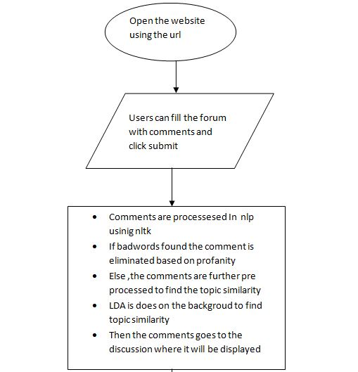
Process Flow

Slide 7
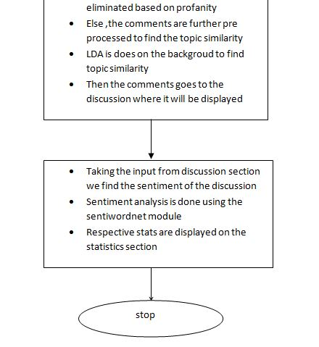

Slide 8
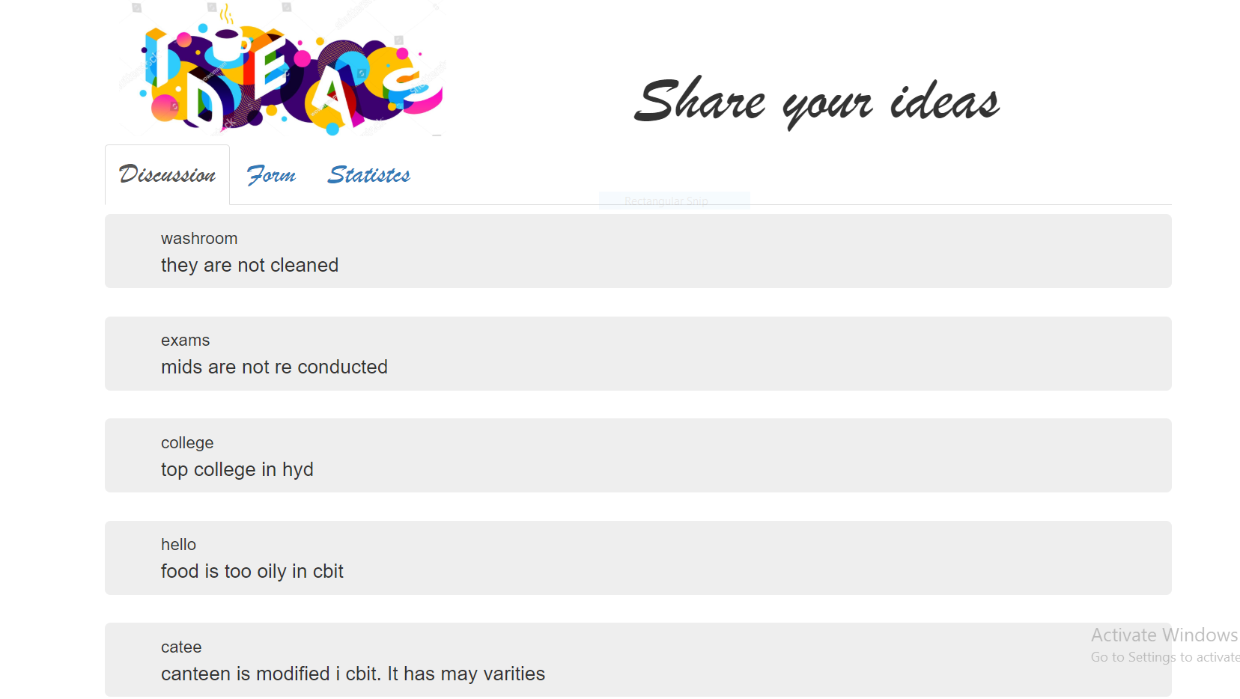
outputs

Slide 9
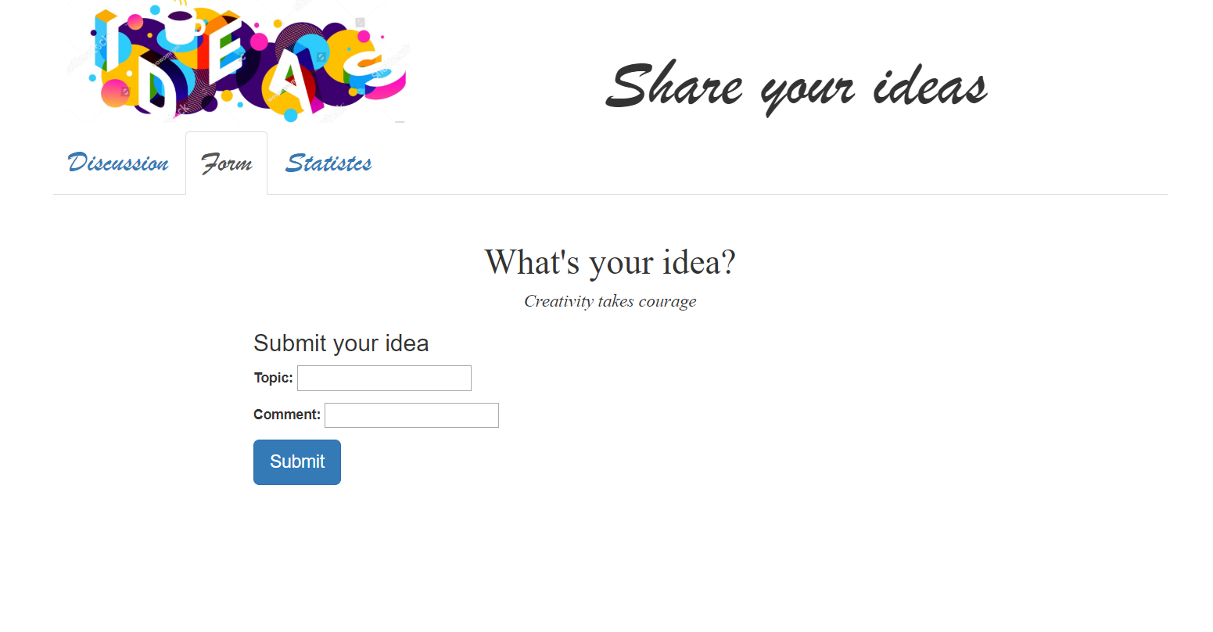

Slide 10
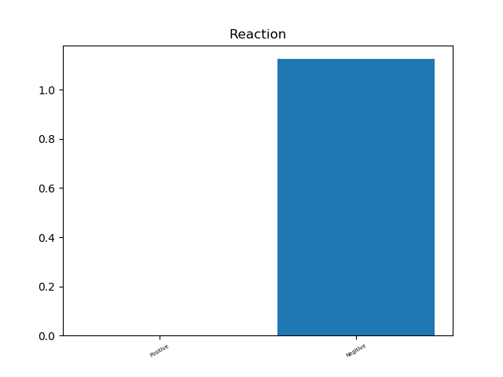

Slide 11
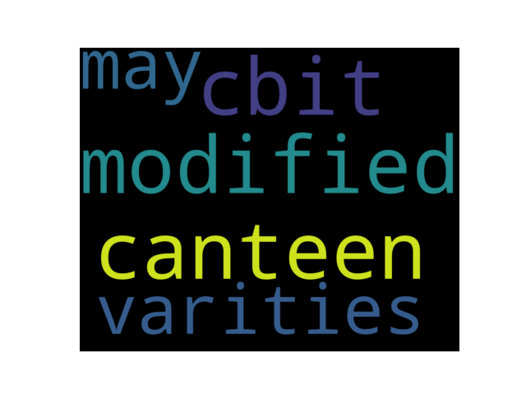

Slide 12
Conclusion
Bad practices will not be encouraged in the website
Students can write comments ananoumously
It will be a interactive reach and respond user friendly platform to react to their issues

